Slide 1
TNS Group 09 – Project
Placement Management System
Group Members:
Mahesh Dasari - T050602325
MD. Imthiyaz - T050602333
Abhitha- T050602301
Architha- T050602309
Alekhya- T050602306
Goudicherla Suresh -T050602315

Slide 2

Problem Statement
In this project, we will be designing a simple placement management system. Placement management system helps the training and placement officers to overcome the difficulty in keeping records of hundreds and thousands of students and searching the eligible students for recruitment, based on various eligibility criteria of different companies. The Placement Management System is designed to facilitate the recruitment process for
Educational institutions
Students
Employers

Slide 3



Educational Institutions :
Educational institutions plays a crucial role in the Placement Management System. They act as the bridge between students and potential employers. By integrating these elements into the Placement Management System, educational institutions can significantly enhance the placement experience for students and employers alike, ensuring a smoother transition from education to employment.
Students :
Students are central to the entire process in the placement management system. Students play a pivotal role in placement management by actively participating in the process. They must update their profiles, explore job opportunities, and apply to positions that match their skills and interests. By taking ownership of their placement journey, students can enhance their employability and secure better job opportunities.
Employers :
Employers plays a vital role in placement management by partnering with educational institutions to provide job opportunities, internships, and training programs. This collaboration enables students to gain practical experience, develop industry-specific skills, and enhance their employability.

Slide 4

Road Map :
Applications will be developed in following Sprints –
Core Java
POSTMAN->Spring REST Controller-> Service Layer->Spring Data JPA Repository Layer-
>Database

Slide 5

Plan
Design
Generate the skeleton as per class design provided
TDD ( Test-Driven Development ) approach
Identify test cases for each module
Write falling test cases
Convert the test cases in GREEN
3. Implement the case study in incremental manner

Slide 6






MODULES
Certificate Module
Admin Module
College Module
Placement Module
Student Module
User Module

Slide 7






Modules
User Module
User Registration And Authentication
Login / Logout
Role Management
User Profile
Placement Module
Placement Tracking
Student Company Matching
Interview Scheduling
Placement Dashboard
Admin Module
User Management
System Configuration
Security Management
Report Generation
Student Module
Student Registration
Profile Management
Resume Building
Skill Assessment
College Module
Application Tracking
College Profile Management
Communication Tools
Job Posting
Certificate Module
Certificate Generation
Customizable Templates
Verification System
Reporting and Analytics

Slide 8
Class Design
Entity Classes :
Certificate
-id: Long
-int- year
-college: String
College
-id: Long
-collegename: String
-location: String
User
-id: Long
-name: String
-type: String
-password: String
Admin
-id: long
-name: String
-password: String
Student
-id: long
-name: String
-roll: long
-qualification: String
-course: String
Placement
-id: Long
-name: String
-qualification: String
-int: year

Slide 9






Class Design
Service Interface:
ICertificateService
IUserService
IPlacementService
+Placement savePlacement(Placement);
+List<Placement> fetchPlacementList();
+fetchPlacementById(long id);
+void deletePlacementById(long id); +updatePlacement(long placementId, Placement placement);
+saveCertificate(Certificate)
+List<Certificate> fetchCertificateList()
+void deletecertificatetById(Longid)
+fetchCertificateById(Longid)
+updateCertificate(long Id)
+fetchCertificateById(String string)
+User saveUser(User user);
+fetchUserList(); +fetchUserById(Long Id);
+deleteUserById(Long Id);
+User updateUser(long Id, user);
IStudentService
ICollegeService
IAdminService
+Student saveStudent(Student student);
+fetchStudentList(); +fetchStudentById(Long Id);
+deleteStudentById(Long Id);
+Student updateStudent (long Id, Student);
+College saveCollege(College College);
+fetchCollegeList(); +fetchCollegeById(Long Id);
+deleteCollegeById(Long Id);
+CollegeupdateCollege (long Id, College);
+Admin save Admin(Admin admin);
+fetch AdminList();
+fetchAdminById(Long Id);
+deleteAdminById(Long Id);
+Admin updateAdmin(long Id, Admin);

Slide 10






Class Design
Repository Interface:
ICertificateRepository
+addCertificate(Certificate certificate):Certificate
+updateCertificate (Certificate certificate):Certificate
+searchCertificate(long Id):Certificate
+deleteCertificate(long Id):Certificate
IStudentRepository
+addStudent(Student student):Student
+updateStudent(Student student):Student
+searchStudentById(long Id):Student
+searchStudentList(Student student):Student
+deleteStudent(long Id):boolean
IUserRepository
+addNewUser(User user): User +updateUser(User user):User
+searchUser(long Id):User
+deleteUser(long id): User
ICollegeRepository
+addCollege(College college): College
+updateCollege(College college): College
+searchCollege(long id): College +deleteCollege(long id):Boolean
IPlacementRepository
+addPlacement(Placement placement):Placement
+updatePlacement(Placement placement):Placement
+search Placement(long id): Placement
IAdminRepository
+addadmin(Admin admin):Admin
+updateAdmin(Admin admin):Admin
+searchAdmin(long Id):Admin
+deleteAdmin(long Id):Boolean

Slide 11
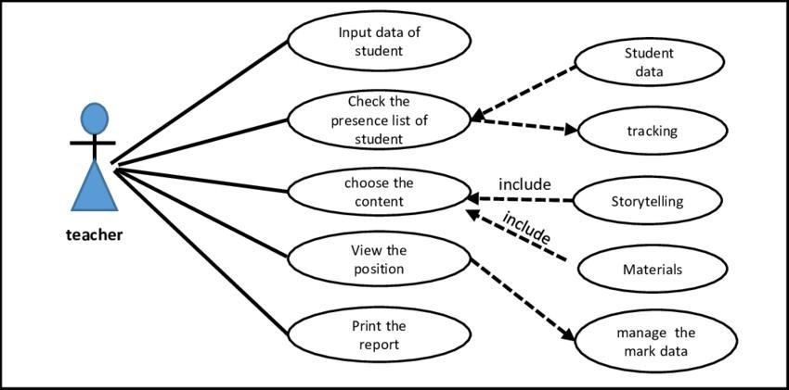
Use Case Diagrams:
Use case diagram for Educational Institutions

Slide 12
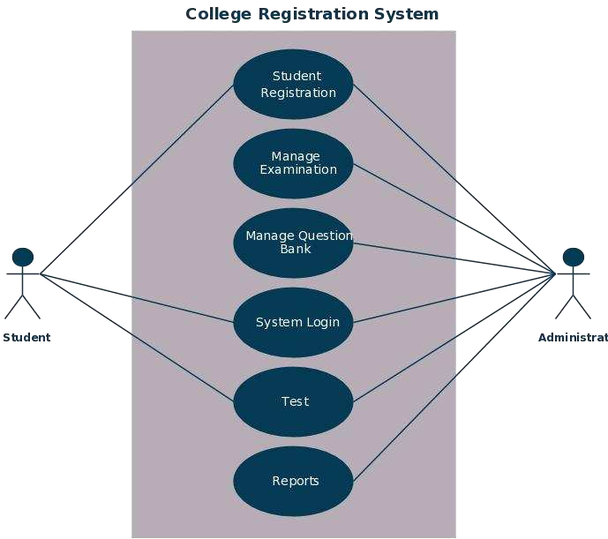
Use Case Diagrams:
Use case diagram for Student

Slide 13
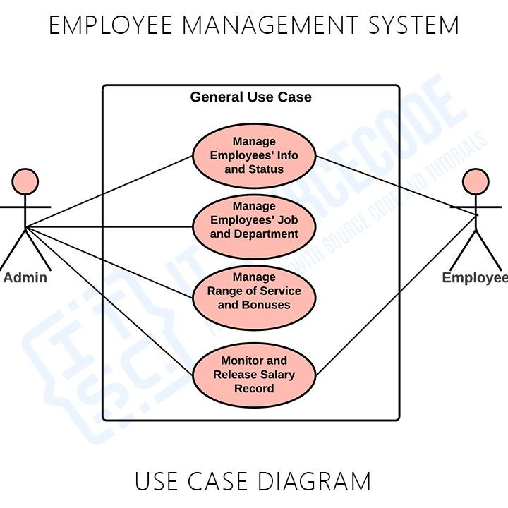
Use Case Diagrams:
Use case diagram for Employers

Slide 14
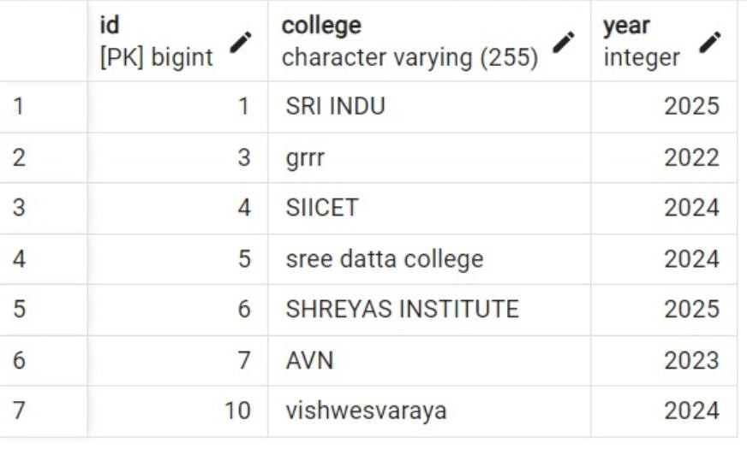
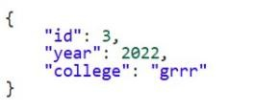
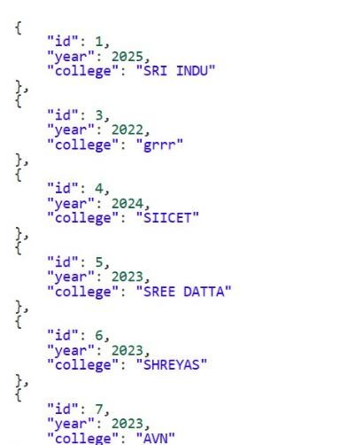
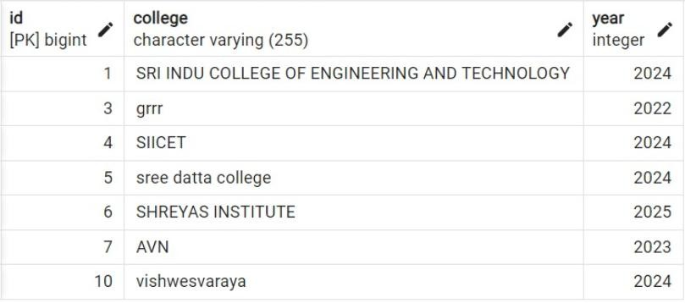
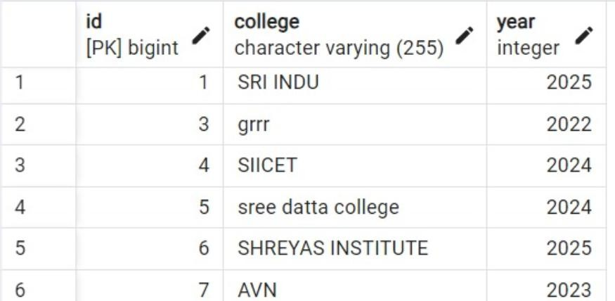
OUTPUT : CERTIFICATE ENTITY
Inserted records using POST Mapping:
http://localhost:8083/certificates
Read specific records using GET Mapping:
http://localhost:8083/certificates/3
Read records using GET Mapping:
http://localhost:8083/certificates
Update records using PUT Mapping:
http://localhost:8083/certificates/1
Deleted record using DELETE Mapping: http://localhost:8083/certificates/2
Certificates deleted successfully!!

Slide 15
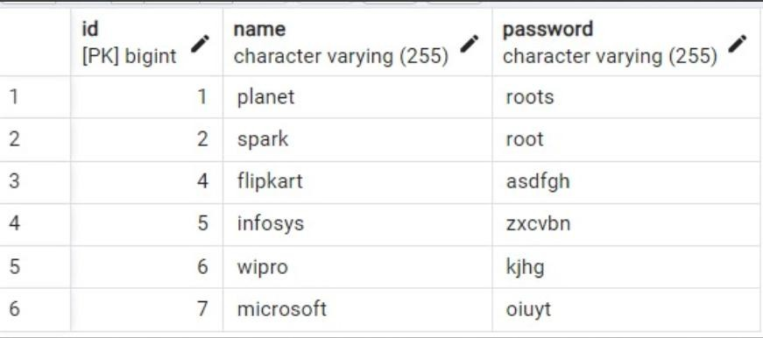
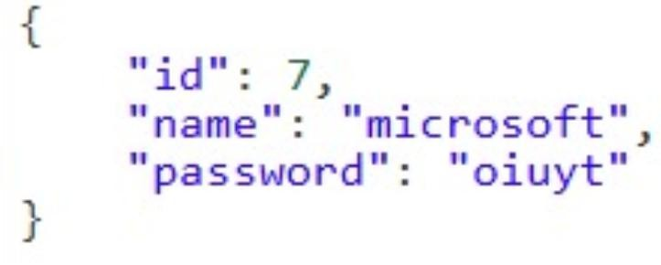
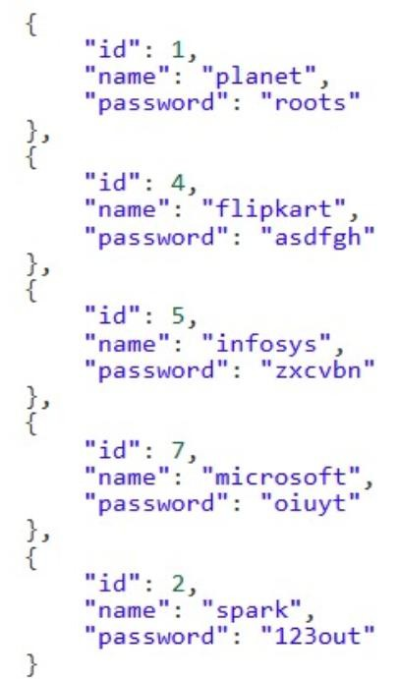
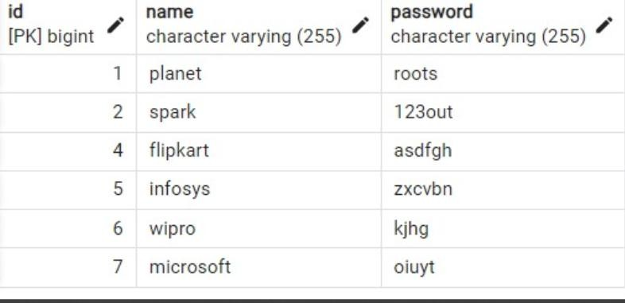
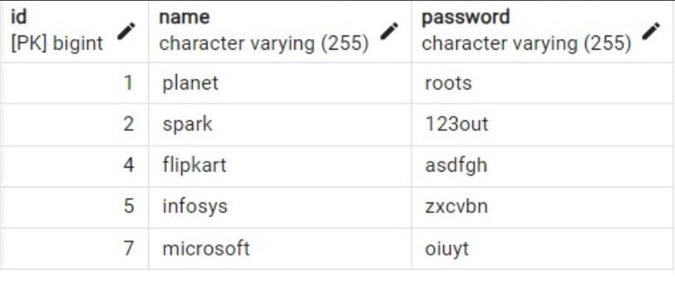
OUTPUT : ADMIN ENTITY
Inserted records using POST Mapping:
http://localhost:8086/admin
Read specific records using GET Mapping:
http://localhost:8086/admin/7
Read records using GET Mapping:
http://localhost:8086/admin
Update records using PUT Mapping:
Deleted record using DELETE Mapping:
http://localhost:8086/admin/6
Admin deleted successfully!!
http://localhost:8086/admin/2

Slide 16
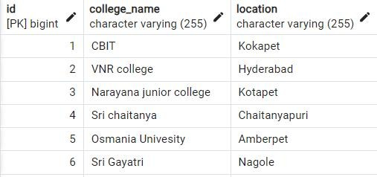

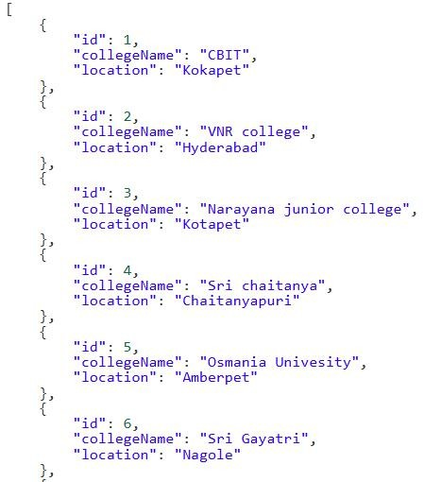
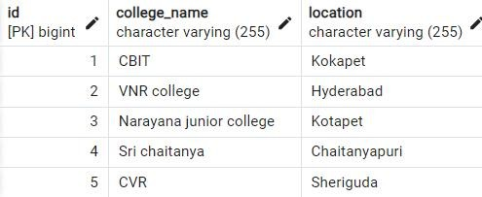
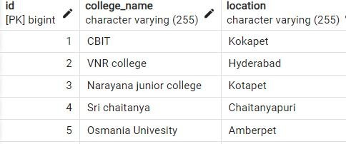
OUTPUT : COLLEGE ENTITY
Inserted records using POST Mapping:
http://localhost:8080/college
Read specific records using GET Mapping:
http://localhost:8080/college/6
Read records using GETMapping:
http://localhost:8080/college
Update records using PUT Mapping:
http://localhost:8080/college/5
Deleted record using DELETE Mapping:
http://localhost:8080/college/6 College deleted successfully

Slide 17
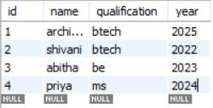
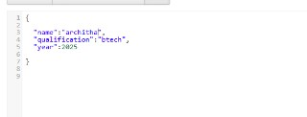
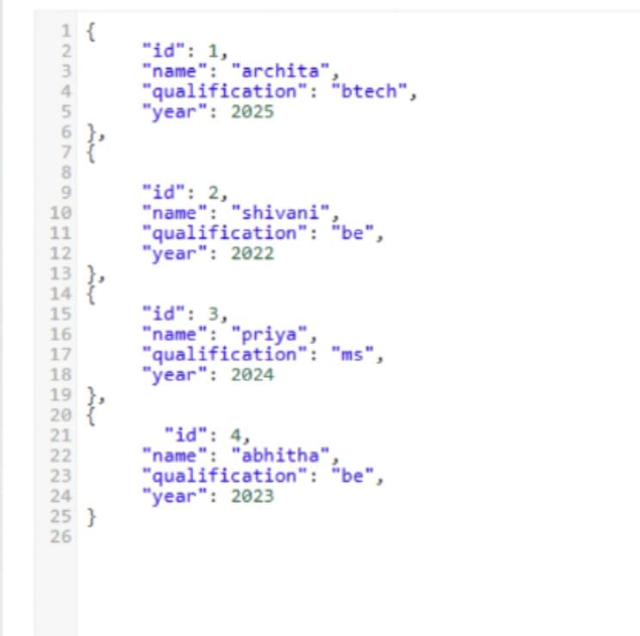
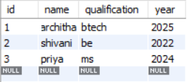
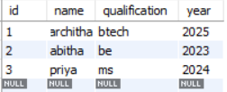
OUTPUT : PLACEMENT ENTITY
Inserted records using POST Mapping:
http://localhost:8080/placement
Read specific records using GET Mapping:
http://localhost:8080/placement/2
Record records using GET Mapping:
http://localhost:8080//placement:
Deleted record using DELETE Mapping:
http://localhost:8080/placement Placement deleted successfully!!
Update records using PUT Mapping:
http://localhost:8080/placement/3

Slide 18
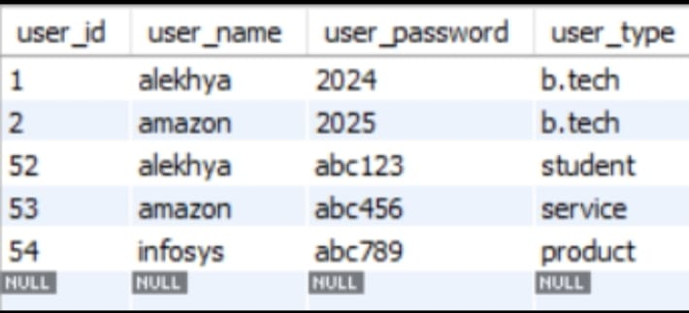
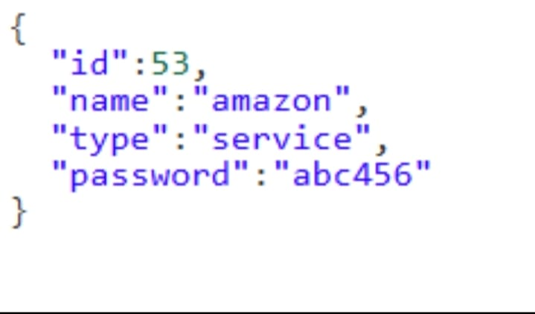
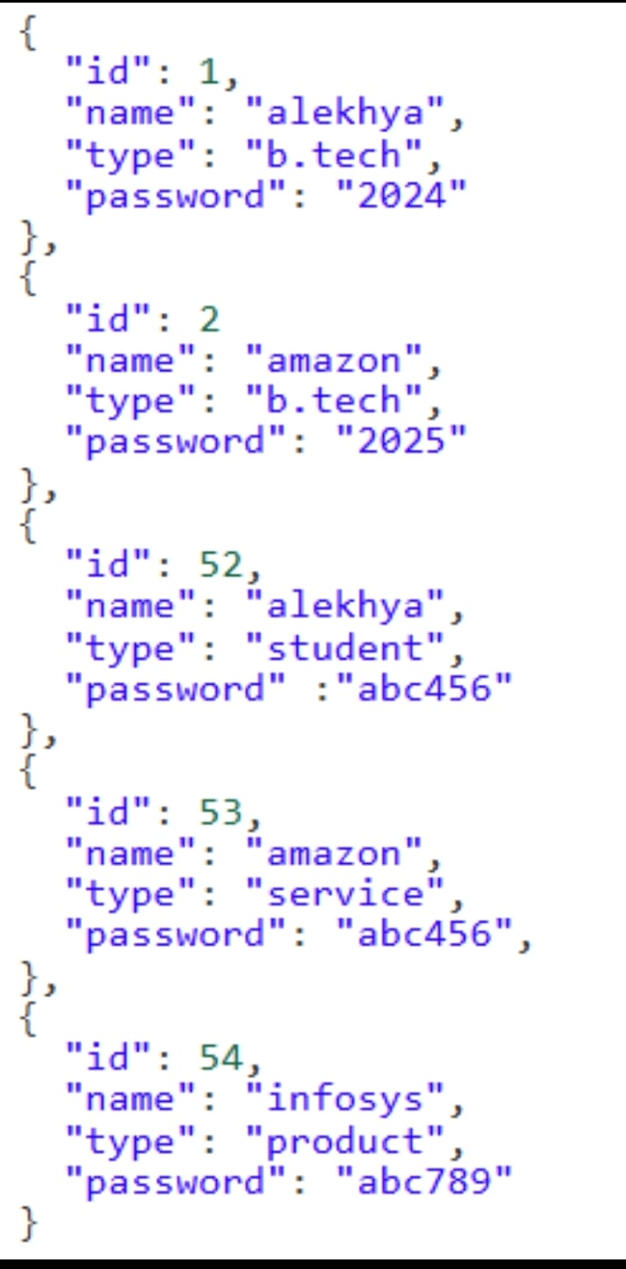
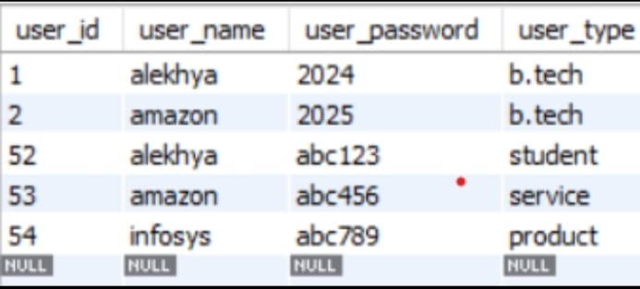
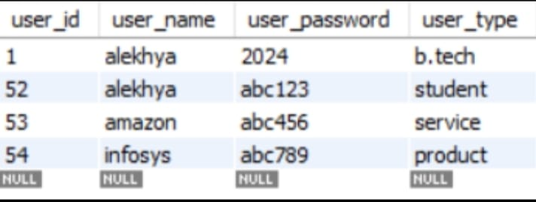
OUTPUT : USER ENTITY
Inserted records using POST Mapping:
http://localhost:8080/user
Read records using GET Mapping:
http://localhost:8080/user
Read specific records using GET Mapping:
http://localhost:8080/user/53
Deleted record using DELETE Mapping:
http://localhost:8080/user/2
User deleted successfully!!
Update records using PUT Mapping:
http://localhost:8080/user/52

Slide 19
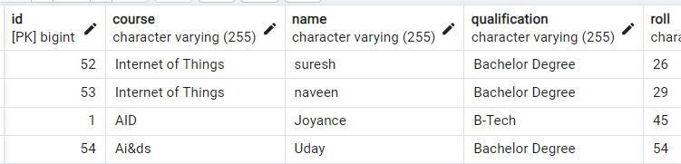
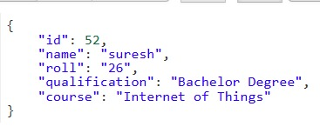
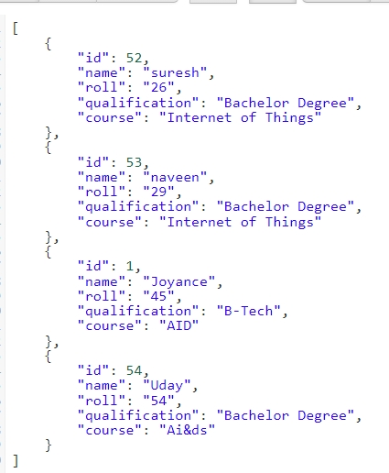
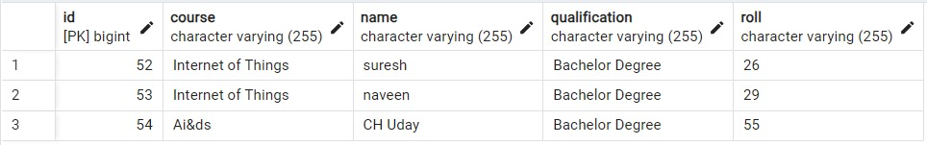
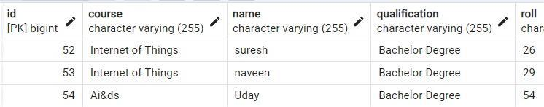
OUTPUT : STUDENT ENTITY
Inserted records using POST Mapping:
http://localhost:8080/student
Read specific record using GET Mapping:
http://localhost:8080/student/2
Read the records using GET Mapping:
http://localhost:8080/student
Update records using PUT Mapping:
http://localhost:8080/student/
Deleted record using DELETE Mapping: http://localhost:8080/student/3 Stud deleted successfully!!

Slide 20
PROJECT CONCLUSION
This project assists in automating the existing manual system.
This is a paperless work.
It provides accurate information always.
Reduces the man power required
PROJECT CONTRIBUTORS
Name | Entity
D.Mahesh | Certificate
Md.Imthiyaz | Admin
Architha | Placement
Name | Entity
Alekhya | User
Abhitha | College
Goudicherla Suresh | Student

Slide 21
THANK YOU..!

